Slide 1
GitHub Classroom For Student
OIL Lab

Slide 2
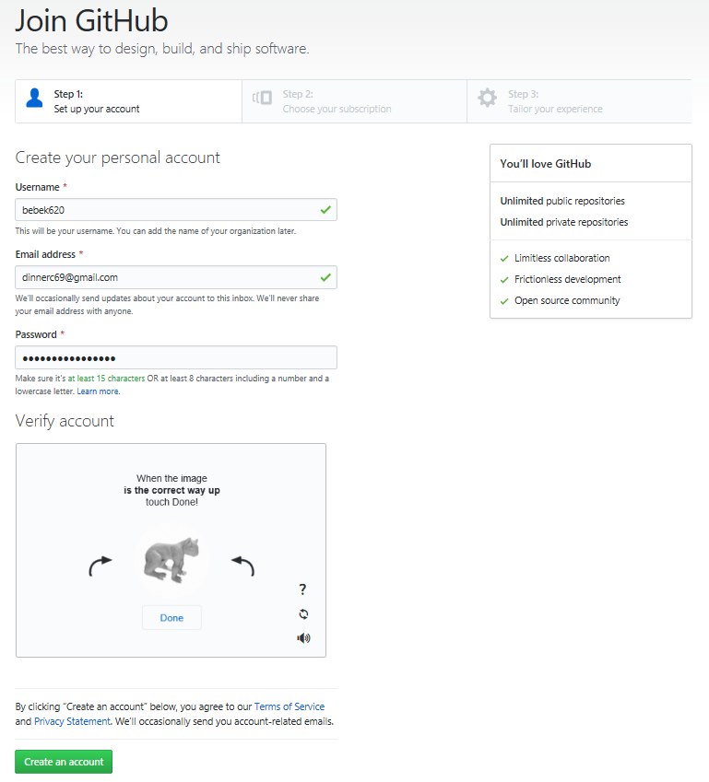
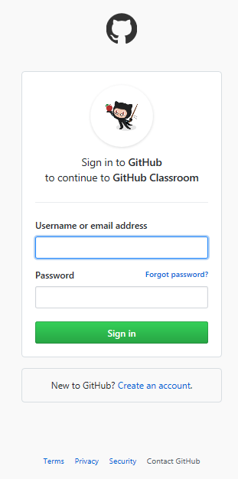
Create New account if you don’t have GitHub account
Explanation:
Step 01 :
Step 02 :
Step 03 :
Step 04 :
Step 05 :
Step 06 :
STEP 02
STEP 03
STEP 04
STEP 05
STEP 01
STEP 06

Slide 3
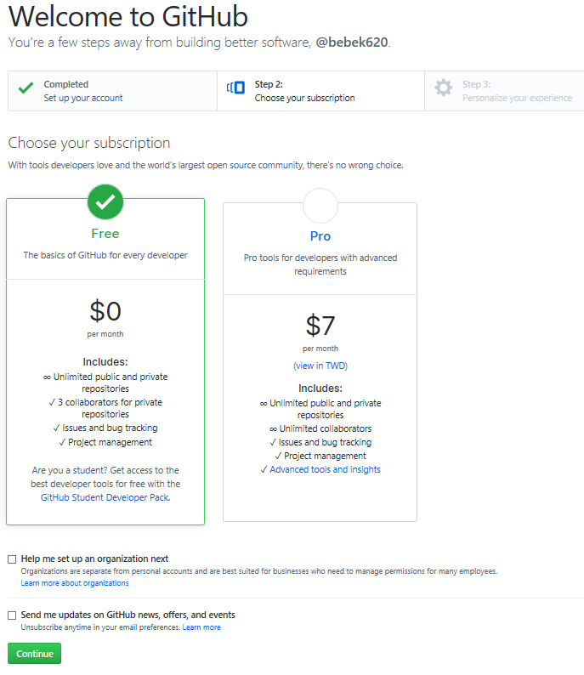
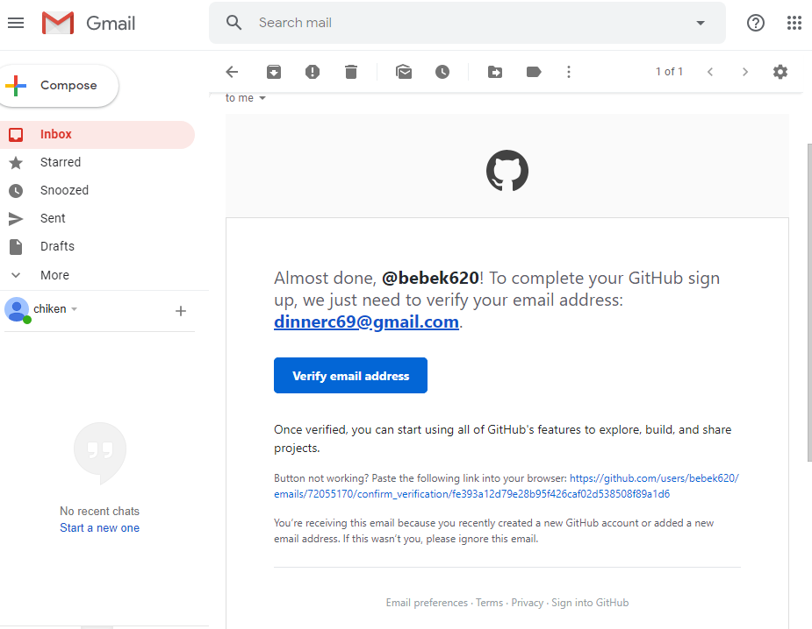
Open email that use for register GitHub account and verify email address
Make sure to select free mode
STEP 08
STEP 07

Slide 4
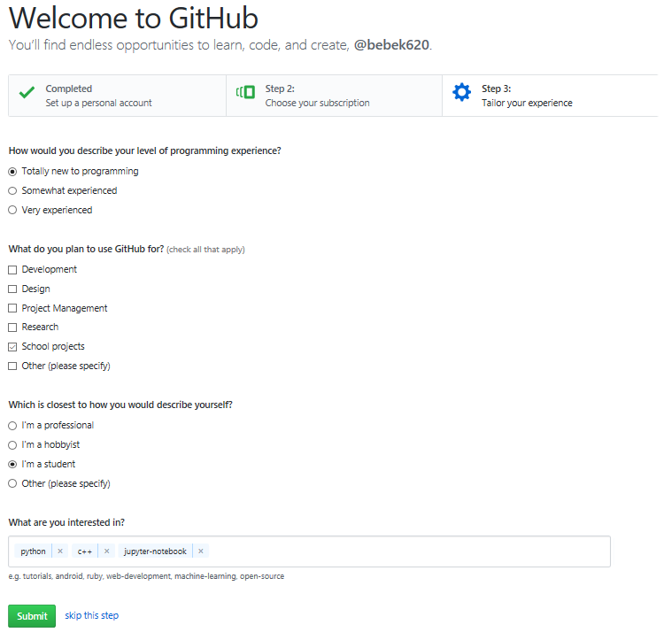
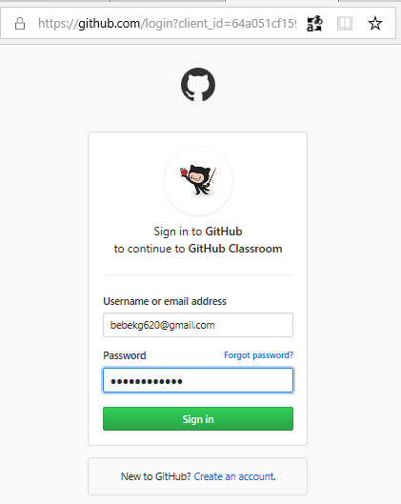
Open URL Assignment you get from techer in browser
STEP 09
Fill using username and password GitHub account
STEP 09
STEP 10
STEP 12
STEP 11

Slide 5
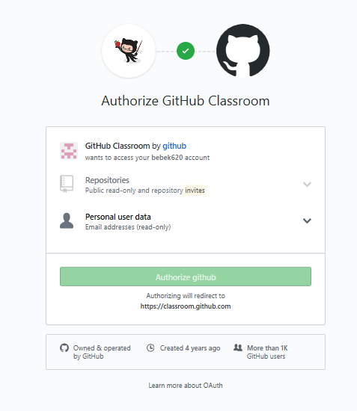
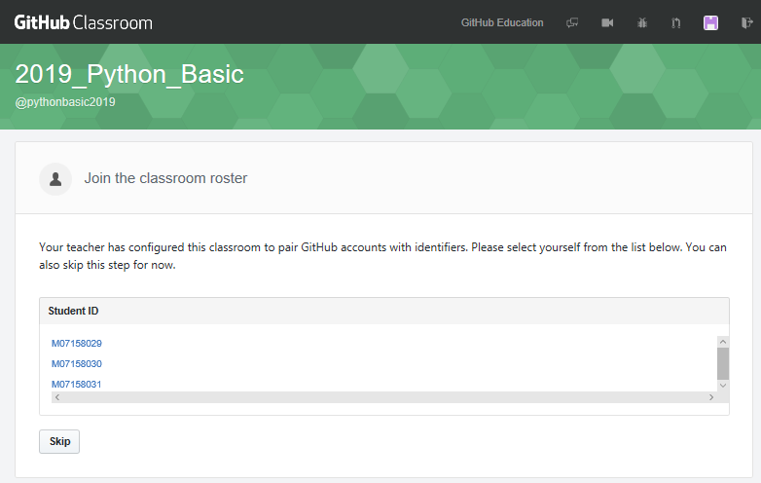
STEP 13
STEP 14
Scroll and chose your student id

Slide 6
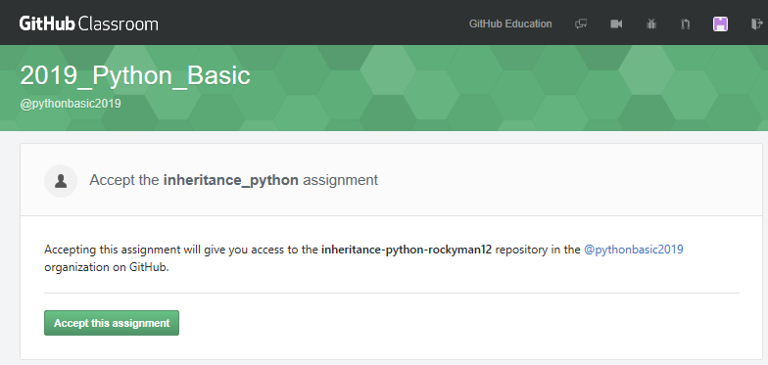
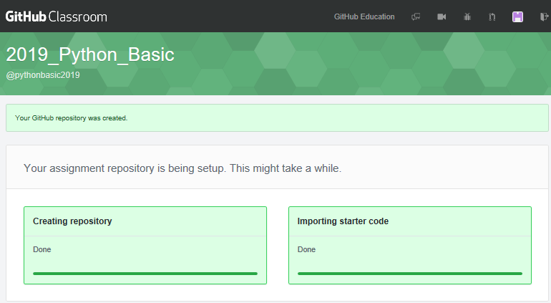
STEP 15

Slide 7

Install Git
Open browser and search Git . Download and install

Slide 8
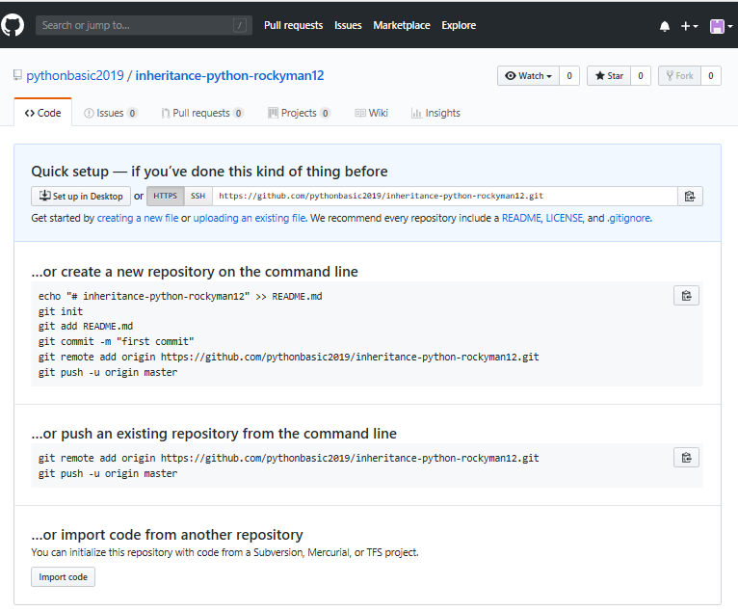
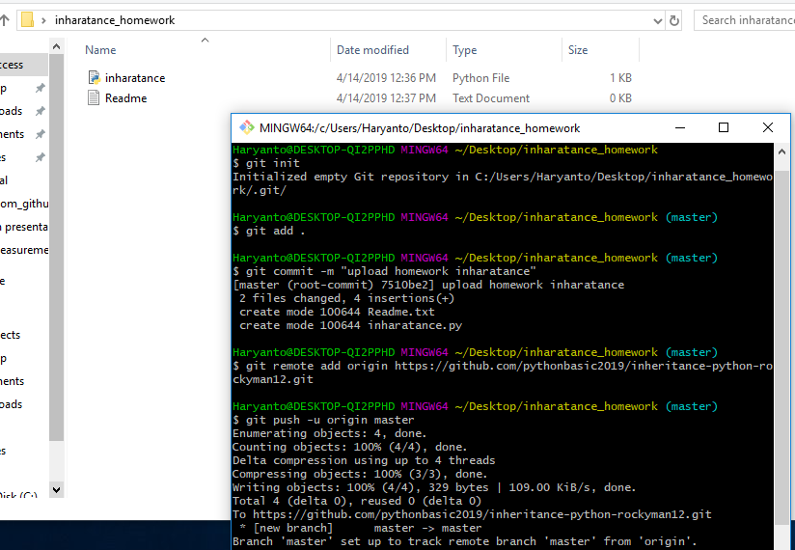
Example Upload your assignment
Open your file assignment in local repository. Right click and chose “Git Bash Here”
Follow the step to upload your file to GitHub repository.
*you must install Git version control in your PC.

Slide 9
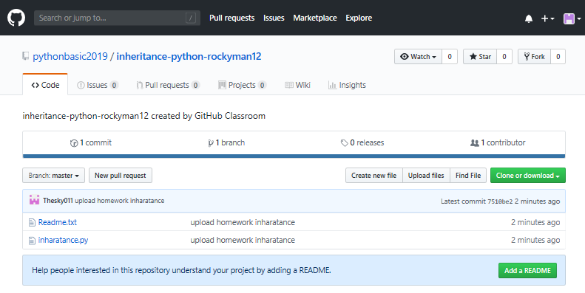
Result, you already upload the file.

Slide 10
Any Question ?

